Slide 1


2025
Hopkins Award for outstanding poster presentation

Slide 2
Hopkins award
In honor of Caleb Hopkins who was one of the founders of the student poster presentations.
Caleb was the epitome of an exemplary Certified Anesthesiologist Assistant and personified passion for education, advancing our profession, research, and mission work.
Caleb’s vision and ideas provided the guidance and foundation for the success of the student poster presentations to grow into the Poster Presentation Committee that we have today.
“To live a life with such noticeable purpose that others continue to work to achieve it after you are gone is so impressive.”
#newlifegoal

Slide 3
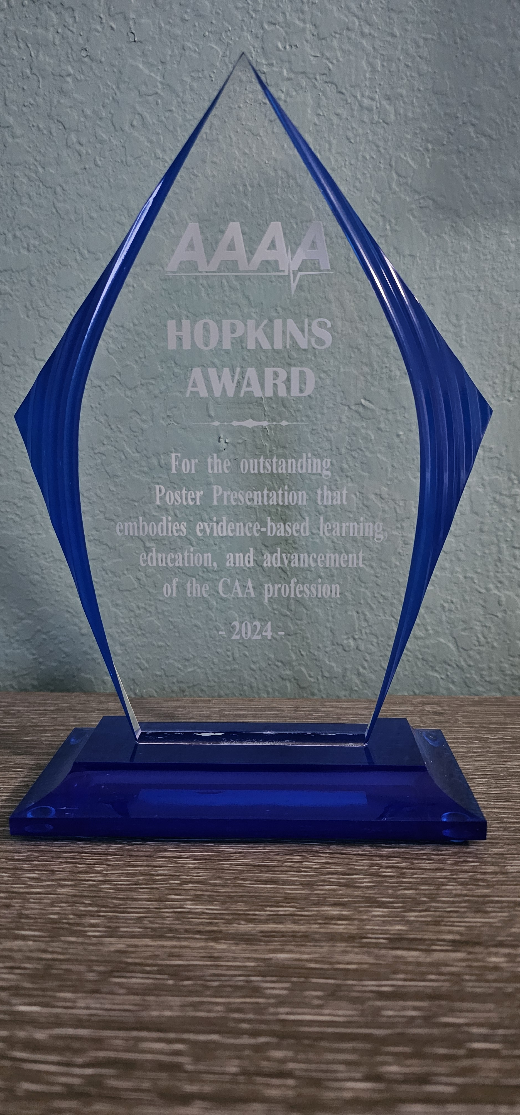
Hopkins award
For the outstanding Poster Presentation that embodies evidence-based learning, education, and advancement of the CAA profession.

Slide 4
2025 poster presentation committee
Poster Submissions Team
Cheryl Saidi-Johnson, CAA
Joy Rusmisell, CAA
Initial Judging Team
Alex Steed, CAA
John Ng, CAA
Paul Krupa-Wilson, CAA
Ralph Dapaah, CAA
Live Presentation Judges Panel
Alex Steed, CAA
Paul Krupa-Wilson, CAA

Slide 5
THANK YOU TO EVERYONE WHO SUBMITTED A POSTER
LIVE POSTER SUBMISSION
VIEWING ONLY POSTER
Alexander Bearup Abigail Becker Ava Bell Elsa Carmona Paige Cassibo Jessica Chlebowski Heran Dhimal Samara Fagan Alayna Forbes Katelin Gary Melissa Gonzalez Michael Herpin Jarrod Holland Ashleigh Hollins Addison Lasserre Lauren Lunar | Joshua Macri Lydia Marek Olivia Miner Autumn Newby William Newman Sikandar Niazi Anthony Patrick Luke Regis-Collier Madisyn Reiakvam Madesyn Ronquillio Emma Scheider Nabeelah Shaheen Julia Starczewski Ava Sutter Alexis Turpin Megan Wilke
Ralph Moleus Lily Alt Ryan Caffrey Rebekeah Chatterjee Christina DiNatale Meagan Doherty Florian Fischer Daniella Flamenco Madeline Gubbini Kaylie Hill Shahin Ismail Ashish Kaushik Theresa Kimball Jenna Klenz Brianna Lanoix Gabriella Metten Robert Moser | Karissa Murphy Brandon Nguyen Anthony Patrick Madelyn Rabideau Eric Shen Stephen Soloff Grace Swenson Mackenzie Thomas Jasmine Thompson Natalie Tyley Benjamin Ulrich Andres Vasquez Erika Wilson Ellen Wolfe Fouad Yassa Yifu Zhu

Slide 6
poster presentation committee:
transparency →The process and unbiasedness
IDENTIFIED POSTER
HIDDEN IN A GALAXY
FAR, FAR, AWAY
SUBMISSIONS
CHECKED
DEIDENTIFIED POSTER
‘3-LETTER CODE’
“POSTER TITLE”
INITIAL JUDGES TEAM
INDEPENDENTLY SCORED
RUBRIC USED
TOP 5
LIVE POSTER PRESENTATIONS
SCORES INDIVIDUALLY SENT TO
POSTER SUBMISSION TEAM
ASSESS FOR OUTLIERS
TABULATE RAW SCORES
JUDGES PANEL
USE RUBRIC FOR
SCORING
TABULATE RAW SCORES
(25%)
OVERALL TOTAL SCORE
(75%)
25% LIVE + 75% INITIAL

Slide 7
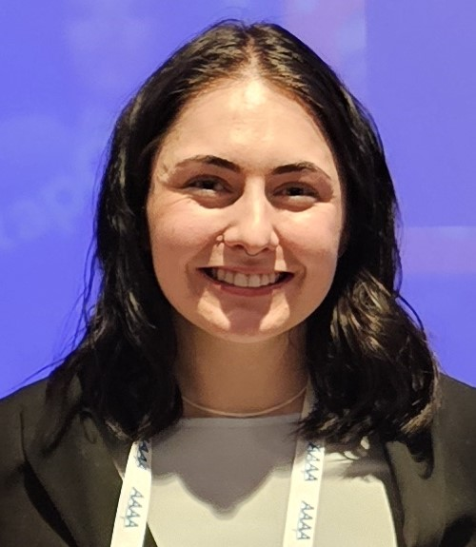
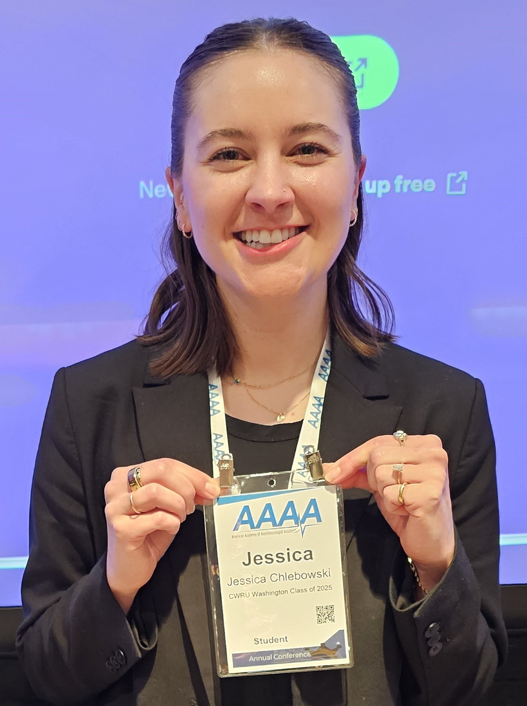
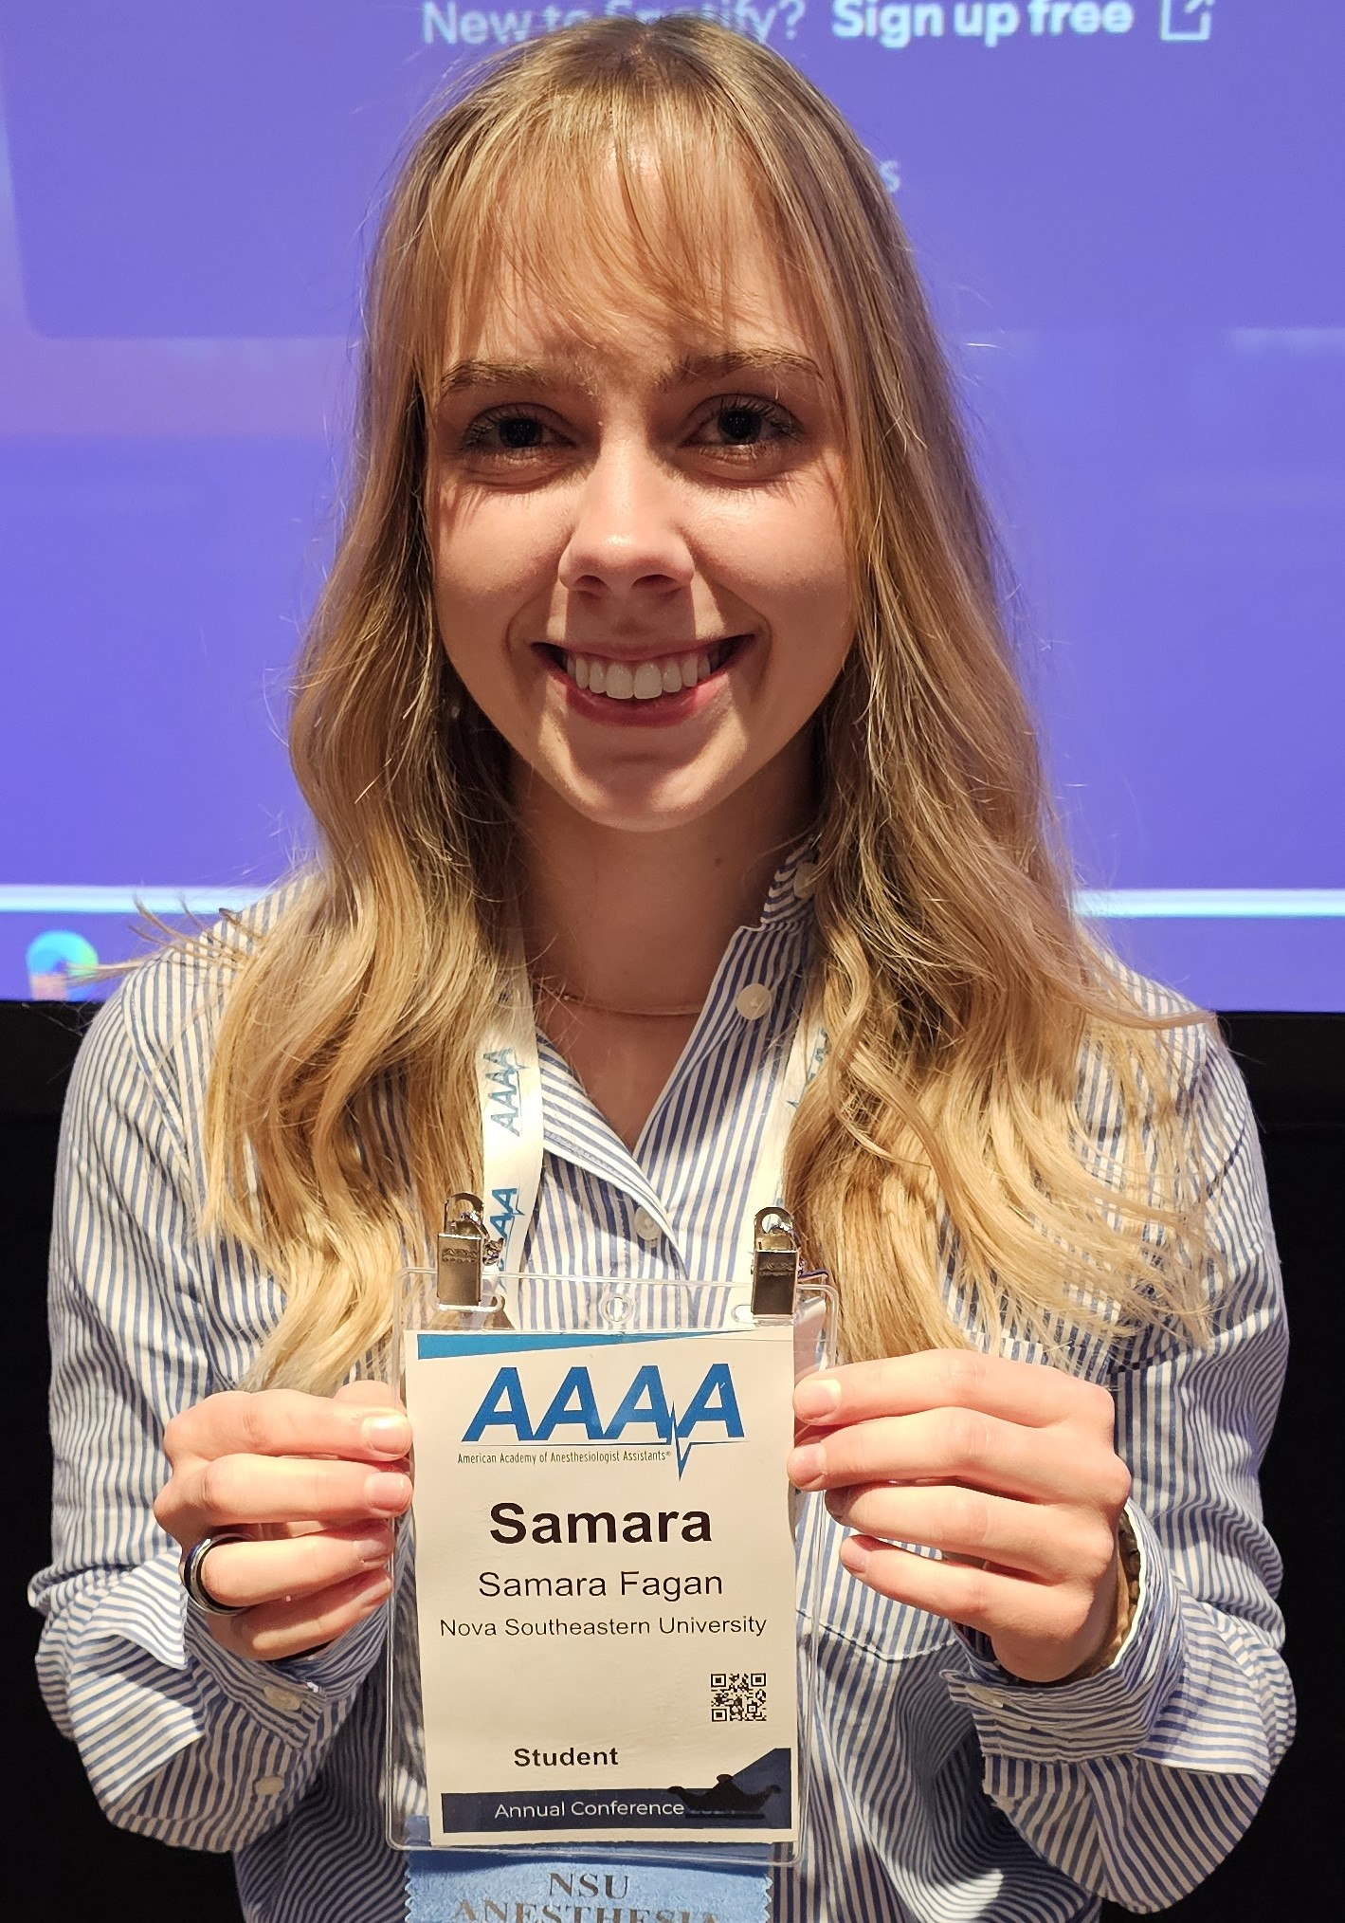
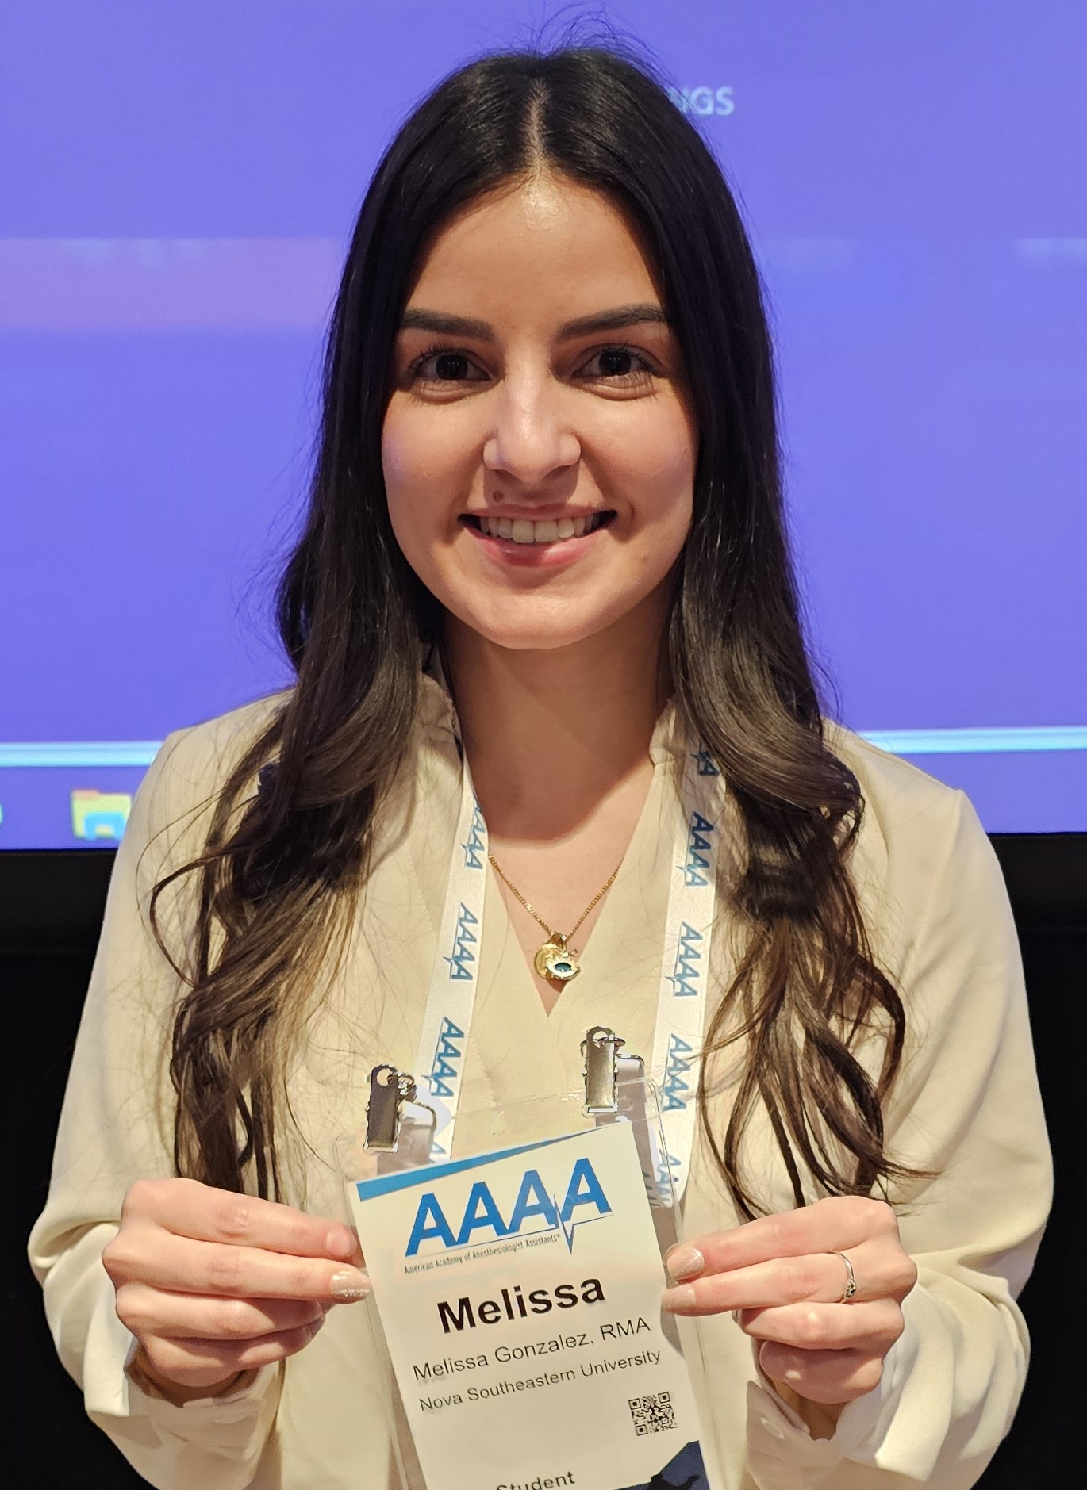
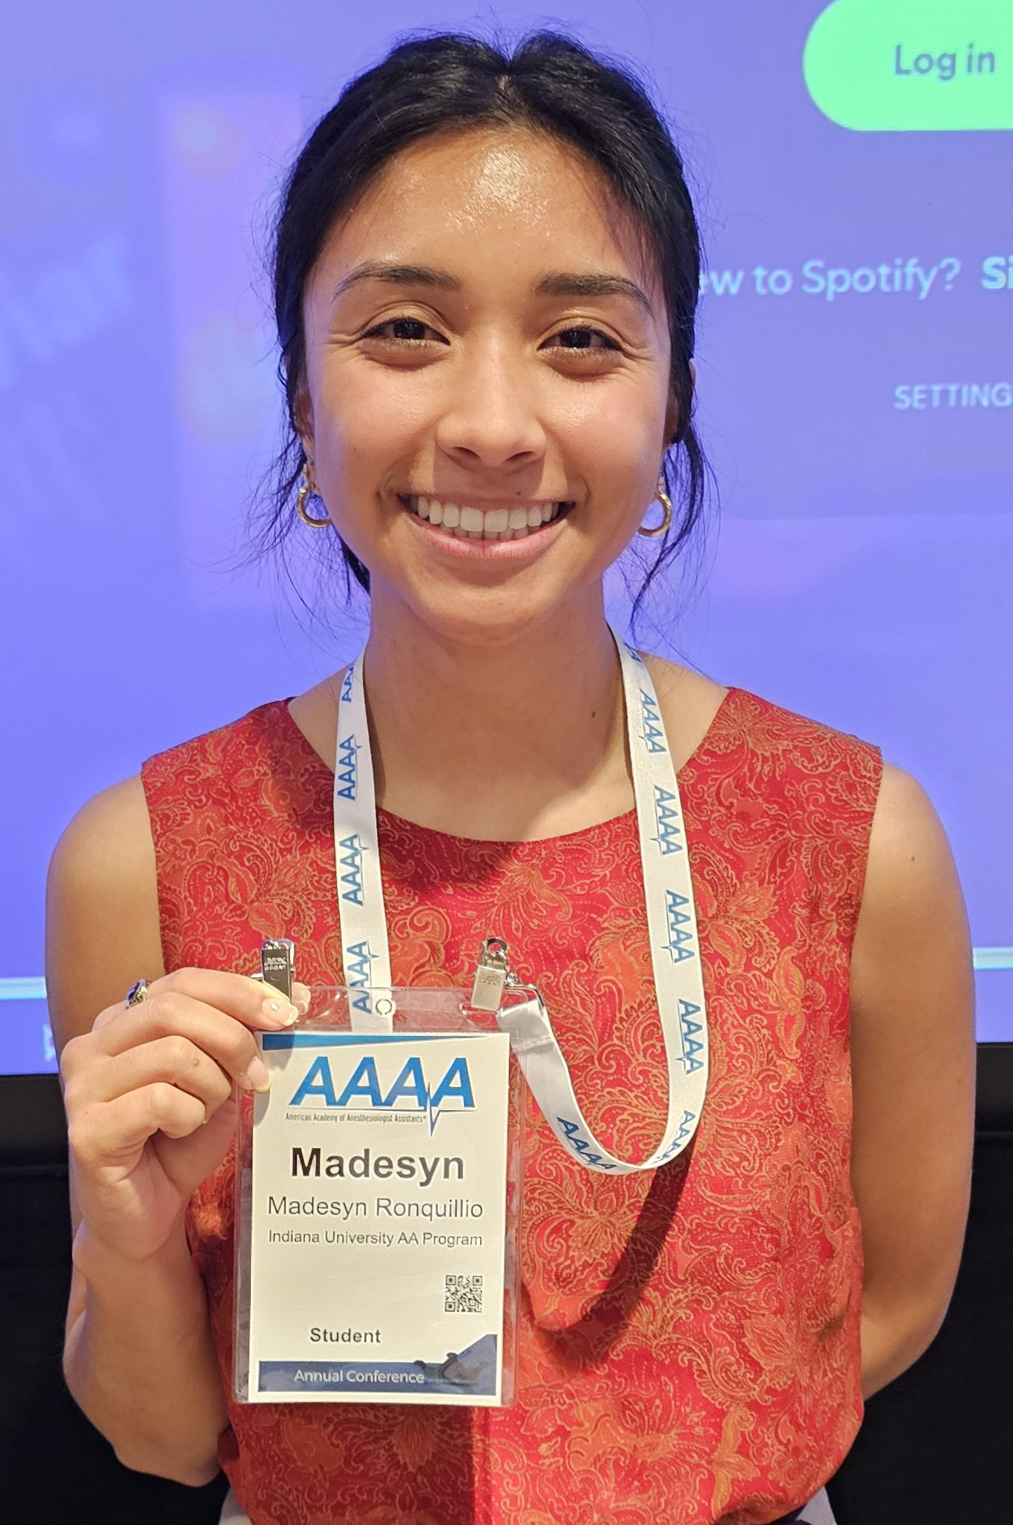
Hopkins award
TOP 5
FINALISTS
PAIGE CASSIBO
JESSICA CHLEBOWSKI
SAMARA “SAM” FAGAN
MELISSA GONZALEZ
MADESYN RONQUILLIO

Slide 8
Madesyn Ronquillio, SAA
INDIANA UNIVERSITY SCHOOL OF MEDICINE
“ARTERIAL BLOOD GAS ALTERATIONS DURING CONGENITAL DIAPHRAGMATIC HERNIA REPAIR IN PREMATURE PEDIATRIC PATIENT”
ADVISOR: RICH BASSI, CAA
Additional authors:
Jennifer rush, caa drew volger, md
2025 HOPKINS AWARD RECIPIENT

